Slide 1
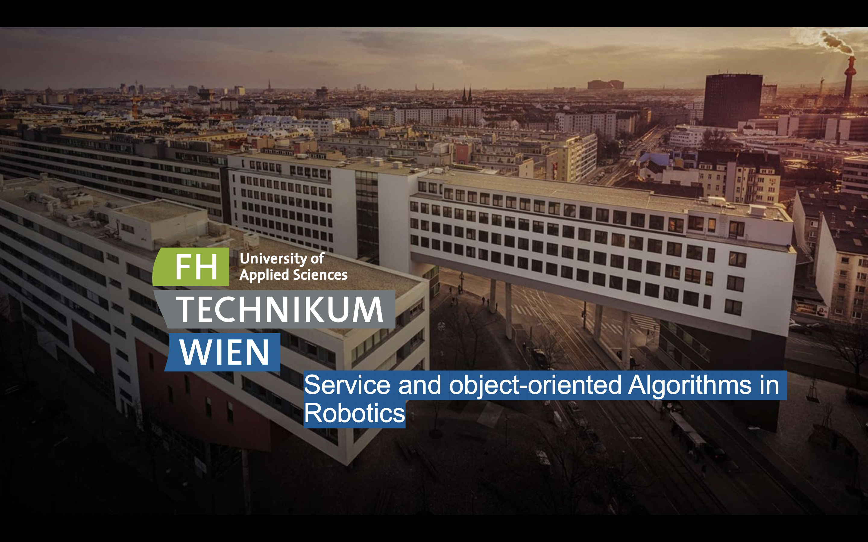
Evan ROUSSIN and Kyrylo STEPHANETS

Slide 2
Project split up
Stepanets Kyrylo
- 1 Step (Loading and transforming Map and Scan from ROS)
- 3 Step (Exit Maze using Search)
- Presentation
Roussin Evan
- 2 Step (Localisation using k-Nearest Neighbour)
- Link it all together
- Documentation and flowchart
1

Slide 3
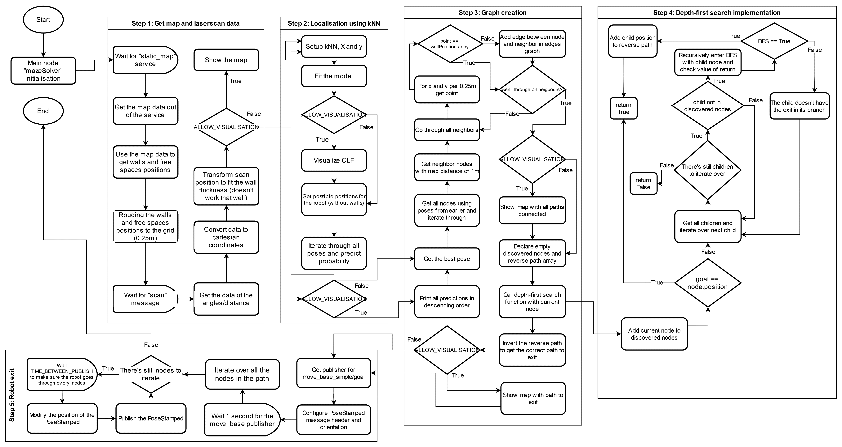
Flowchart
2

Slide 4
Encountered problems when implementing the project
Matplotlib not working in the Docker container
The static map service not being available
Getting the right coordinates for the points in the map
Unabled to visualise the heatmap
Trouble making the depth-first search algorithm implementation
The robot not moving
Script crashing on some specific coordinates
3

Slide 5
Matplotlib not working in the Docker container
One of the other problem in the beginning of the project was to get the static_map service. We started with the first step and the code would crash because the service was not available. We tried to find a solution on the internet but we couldn't find anything. After some time and some tests we figured that we needed to wait for the map to be loaded before trying to get the service. We then added a rospy.wait_for_service('static_map') and it worked!
4

Slide 6
The static map service not being available
The first problem we had was that matplotlib wasn't working in the Docker container when launching the simulation. How our visualisation works is by having static methods to draw plots inside our mapVisualisation.py that can then be used in the mazeSolver.py by accessing the class MapVisualisation. When running the script or launching the simulation, we always had an error thrown by matplotlib. At first we just the package import to make everything work, but at some point we undestood that initially matplotlib was meant to be used inline with the Jupiter notebook but as we were coding on Visual Studio Code with a remote explorer this didn't work. The simple solution was to install the package python -m pip install -U matplotlib as indicated here and then everything worked fine! Keep in mind that you have to install the package each time you launch the Docker container.
5

Slide 7
Getting the right coordinates for the points in the map
The next problem was that initially we easily got the map to be visualized, but the resolution compared to the world coordinates was not correct. Instead of having a map of 4x4 we had something like 20x20. We just forgot the part of the assignment where we had to calculate the positions of the walls and free spaces according to the world coordinates. We then added the calculation and everything worked fine!
6

Slide 8
Unabled to visualise the heatmap
Unfortunately we were not able to visualise the heatmap of the kNN model with the functions given in the project cookbook. Instead we just printed the predictions of the model for each position in the map by descending order in the console.
7

Slide 9
Trouble making the DFS algorithm implementation
At first we tried to implement the depth-first search algorithm by using the pseudo code in the cookbook but we had a lot of trouble making it work fine. We did something a little bit different but in the end it works the same way.
8

Slide 10
The robot not moving
When we finally had the pathfinding algorithm working, we tried to make the robot move. We then noticed that the robot was not moving at all. We tried to find a solution on the internet but we couldn't find anything. When echoing the topic move_base_simple/goal we were not seeing anything getting published, but when moving the robot with RViz the message got published to the topic. At some point we just made a while loop that would publish the message infinitely and it worked. We figured that the topic wasn't up by the time we were publishing the message, so we added a time.sleep() before iterating in each nodes to publish and it worked!
9

Slide 11
Script crashing on some specific coordinates
When everything was finished, we tried to test the script with different coordinates and we noticed that the script would crash on some specific coordinates. We then tried to understand why and we figured that the problem was that for some reason when adding the scans positions to the pose to predict, it would sometimes add inf values to the transformed scan. The model couldn't predict the scan because of this. We then added a check to remove the inf values from the transformed scan and everything worked fine!
10

Slide 12
